Slide 1
MODULE 2: 5G Network Architecture
Introduction to 5G Network Architecture
5G Core Network (5GC
Radio Access Network
Network Slicing: Concept and Implementation;
Virtualization in 5G
Software-Defined Networking (SDN) in 5G
Edge Computing
Mobile Edge Computing
Quality of Service requirements.

Slide 2
MODULE 2: 5G Network Architecture
M2 S4
5G Core Network (5GC)

Slide 3
5G Core (5GC) Service-Based Architecture
A major change in the 5G Core (5GC) architecture compared to 4G and the previous generations is the introduction of the service-based architecture.
In 4G architecture, the control plane functions communicate with each other via the direct interfaces (or reference points) with a standardized set of messages.
In the service based architecture, the Network Functions (NF), using a common framework, expose their services for use by other network functions.
In the 5GC architecture model, the interfaces between the networks functions are referred to as Service Based Interfaces (SBI).
The Service Framework defines the interaction between the NFs over SBI using a Producer–Consumer model.
As such a service offered by a NF (Producer) could be used by another NF (Consumer) that is authorized to use the service.
The services are generally referred to as “NF Service” in 3GPP specifications.

Slide 4
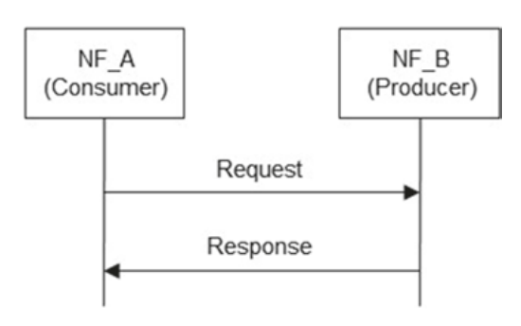
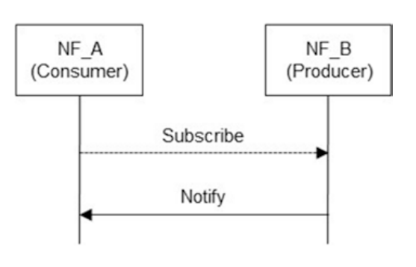
5G Core (5GC) Service-Based Architecture
The interaction between the NFs may be a “Request-response” or a “Subscribe Notify” mechanism.
In the “Request-response” model, an NF (consumer) request another NF (producer) to provide a service and/or perform a certain action (see Fig.a)
In “Subscribe-Notify” model, an NF (consumer) subscribes to the services offered by another NF (producer) which notifes the subscriber of the result (Fig. b)
The communication between the NF Service consumers and NF Service Producers maybe direct or indirect. .

Slide 5
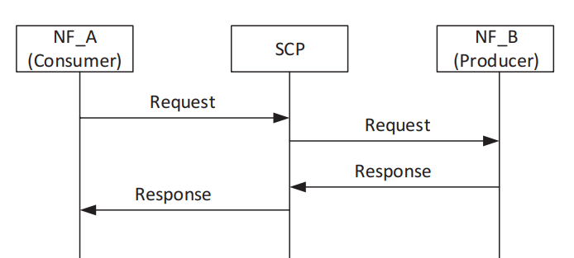
5G Core (5GC) Service-Based Architecture
The indirect communication is via a Service Communication Proxy (SCP).
The SCP is not used for direct Communication.
The NF Service Producer/Consumer may include a Binding Indication in the Response/Request, which may be used by the NF Service Consumer to select a NF service producer instance for subsequent requests or used by the NF Service Producer to discover a suitable notification endpoint.
For indirect communication, the binding indication is used by the SCP to discover a suitable NF service producer instance or a suitable notification target as appropriate

Slide 6
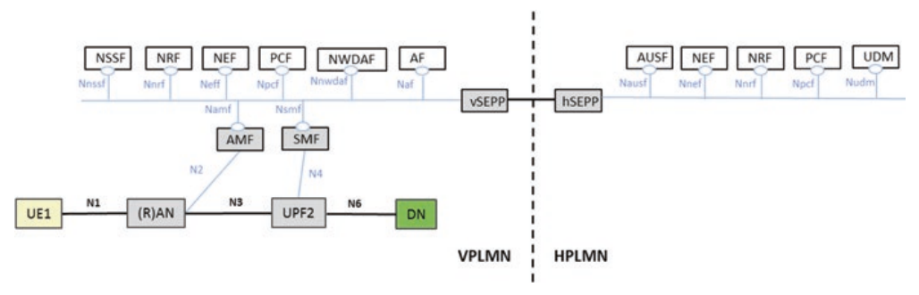
5G Core (5GC) Service-Based Architecture
As can be seen in Fig. in the 5G System Architecture, each network function has an associated service-based interface designation.
For example, “Namf” designates the services exhibited by the Access and Mobility Management function (AMF)

Slide 7
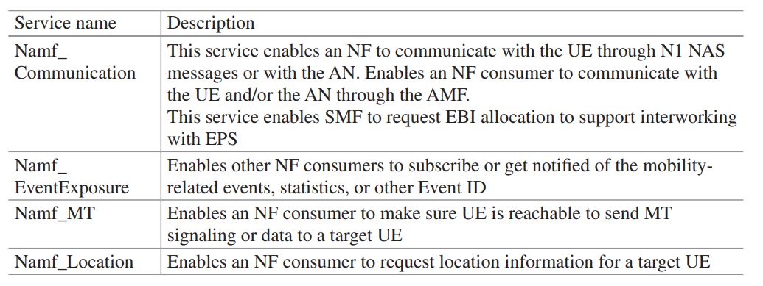
5G Core (5GC) Service-Based Architecture
3GPP specifications define a set of Services that are offered/supported by each Network Function.
For example, the NF services specified for AMF are shown in Table
Access and Mobility Management function

Slide 8
5G Core (5GC) Service-Based Architecture
There are three main procedures associated with the Service Framework as defined in 3GPP:
NF service registration and de-registration: to make the Network Repository Function (NRF) aware of the available NF instances and supported services.
NF service discovery: enables a NF (Consumer) to discover NF instance(s) (Producer) that provide the expected NF service(s). A NF typically performs a Services Discovery procedure with NRF for NF and NF service discovery.
NF service authorization: to ensure the NF Service Consumer is authorized to access the NF service provided by the NF Service Provider (Producer).

Slide 9
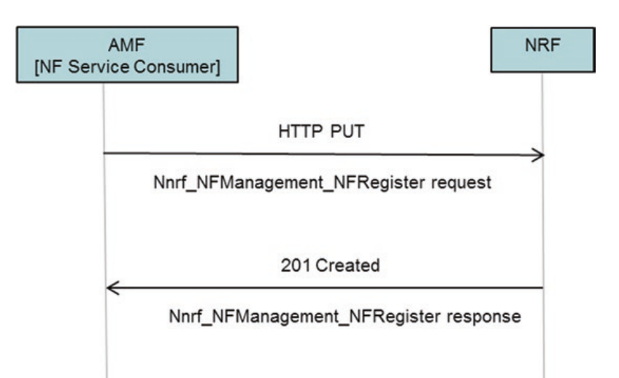
5G Core (5GC) Service-Based Architecture
(Fully Qualified Domain Name)
Network Repository Function
1. Example of NF Service Registration
AMF as the NF service consumer sends a HTTP PUT request to NRF with the resource URI representing the NF Instance.
The request contains Nnrf_NFManagement_NFRegister request message (the NF profile of NF service consumer) to NRF to inform the NRF of its NF profile.
The NF profile of NF service consumer includes information such as NF type, FQDN or IP address of NF, names of supported services, etc.
The NRF authorizes the request and upon success stores the NF profile of NF service consumer and marks the NF service consumer available.
The NRF acknowledges the success of AMF Registration by returning a HTTP 201Created response containing the Nnrf_NFManagement_NF Register response (including the NF profle).

Slide 10
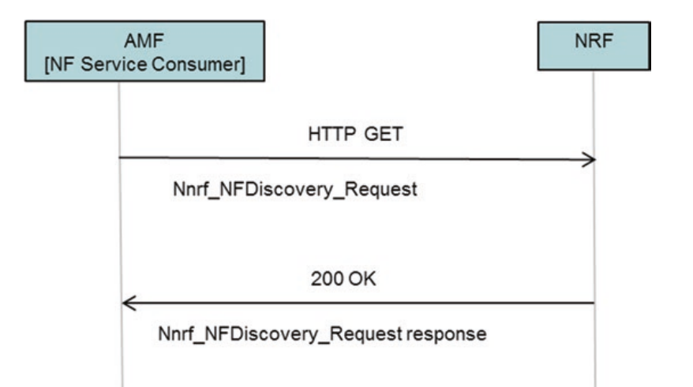
5G Core (5GC) Service-Based Architecture
(Fully Qualified Domain Name)
2. Example of NF Service Discovery
The AMF as NF service consumer intends to discover NF instances or services available in the network for a targeted NF type.
The AMF sends HTTP GET request to NRF in the same PLMN by invoking Nnrf_NFDiscovery_Request.
This request contains Expected NF service Name, NF Type of the expected NF instance, NF type of the NF consumer, and may also include other information/parameters such as Subscription Permanent Identifier (SUPI), AMF Region ID, etc.
The NRF authorizes the request, and if allowed the NRF determines the discovered NF instance(s) or NF service instance(s) and provides the search results to the NF service consumer (e.g., AMF) in a HTTP 200 OK.
Network Repository Function

Slide 11
!!THANK YOU!! !! Have a Nice Day!!
Today we learned about
5G Core Network (5GC)

